Slide 1
PIP4004: UNIVERSITY PROJECT
Review-3 Presentation PSCS-399 : EduBot: AI-Powered Student Assistance Chatbot
Batch Number: CST - 09
Under the Supervision of,
Ms. Radhika Sreedharan
Assistant Professor
School of Computer Science and Engineering
Presidency University
Roll Number | Student Name
20211CST0033 | MAIMOONA MAHMOOD
20211CST0079 | HARSHIT RANJAN
20201CST0015 | INDRAJITH M
20211CST0119 | TEJO SAI YASWANTH K
Name of the Program: B.Tech. Computer Science & Technology
Name of the HoD: Saira Banu Atham
Name of the Program Project Coordinator: Dr. Manjula HM
Name of the School Project Coordinators: Dr. Sampath A K / Dr. Abdul Khadar A / Mr. Md Ziaur Rahman

Slide 2
Introduction
Education is evolving with the integration of artificial intelligence, offering new solutions to traditional learning challenges. Many students struggle with finding personalized resources, tracking their academic progress, and receiving tailored guidance for improvement. Traditional methods, such as manual searches and static study materials, often fail to provide dynamic and adaptive learning experiences.
This project aims to develop an AI-powered educational assistant that enhances learning by leveraging generative AI and analytical tools. The system integrates AI-based chat interaction, web search for relevant study materials, and student performance tracking through graphical analysis. The key advantages of this system include:
Personalized Assistance: AI chatbot provides customized guidance based on user queries.
Efficient Resource Retrieval: Web search function fetches relevant study materials automatically.
Performance Monitoring: Graphical representation of exam results helps students analyze their progress.
User-Friendly Interface: Simplifies the process of learning and self-assessment.
Applications of this system extend to students, educators, and self-learners, offering a seamless and interactive educational experience.

Slide 3
Literature Review
Bhavika R. Ranoliya et al. Developed a university chatbot using AIML based on ELIZA and ALICE, focusing on automating FAQ responses for educational institutions.
Madhumitha S. et al. Conducted a comparative analysis of AIML and ChatScript, evaluating their capabilities in chatbot development and deployment.
Shang-Pin Ma and Ching-Ting Ho Proposed a flow-based chatbot model featuring visual design tools and webhook integration, compared with existing platforms like RedBot.
Graciane X. Nobre et al. Analyzed cloud-based NLU platforms (Dialogflow, Wit.ai, LUIS, Watson, Amazon Lex) based on usability, supported languages, and pricing models.
Neelkumar P. Patel et al. Designed "Unibot" with a GUI that provides academic information using PHP, jQuery, and HTML for seamless student interactions.

Slide 4
Literature Review
Nahdatul Akma Ahmad et al. Developed "UNISEL Bot" using PHP and MySQL to assist the university’s marketing team by handling FAQs from students.
Naing Naing Khin & Khin Mar Soe Created a university chatbot using AIML that supports the Myanmar language, improving accessibility for local students.
B. Arunkumar Built a chatbot using AIML and Python to facilitate university-related queries and automate responses efficiently.
E. Kasthuri & Dr. S. Balaji Implemented an educational chatbot utilizing deep learning to assist students with lab manual queries and coursework explanations.
Athira Susan George et al. Reviewed multilingual chatbots in India, including Aham, Haptik, and vernacular.ai, aimed at bridging communication gaps across Indian languages.

Slide 5
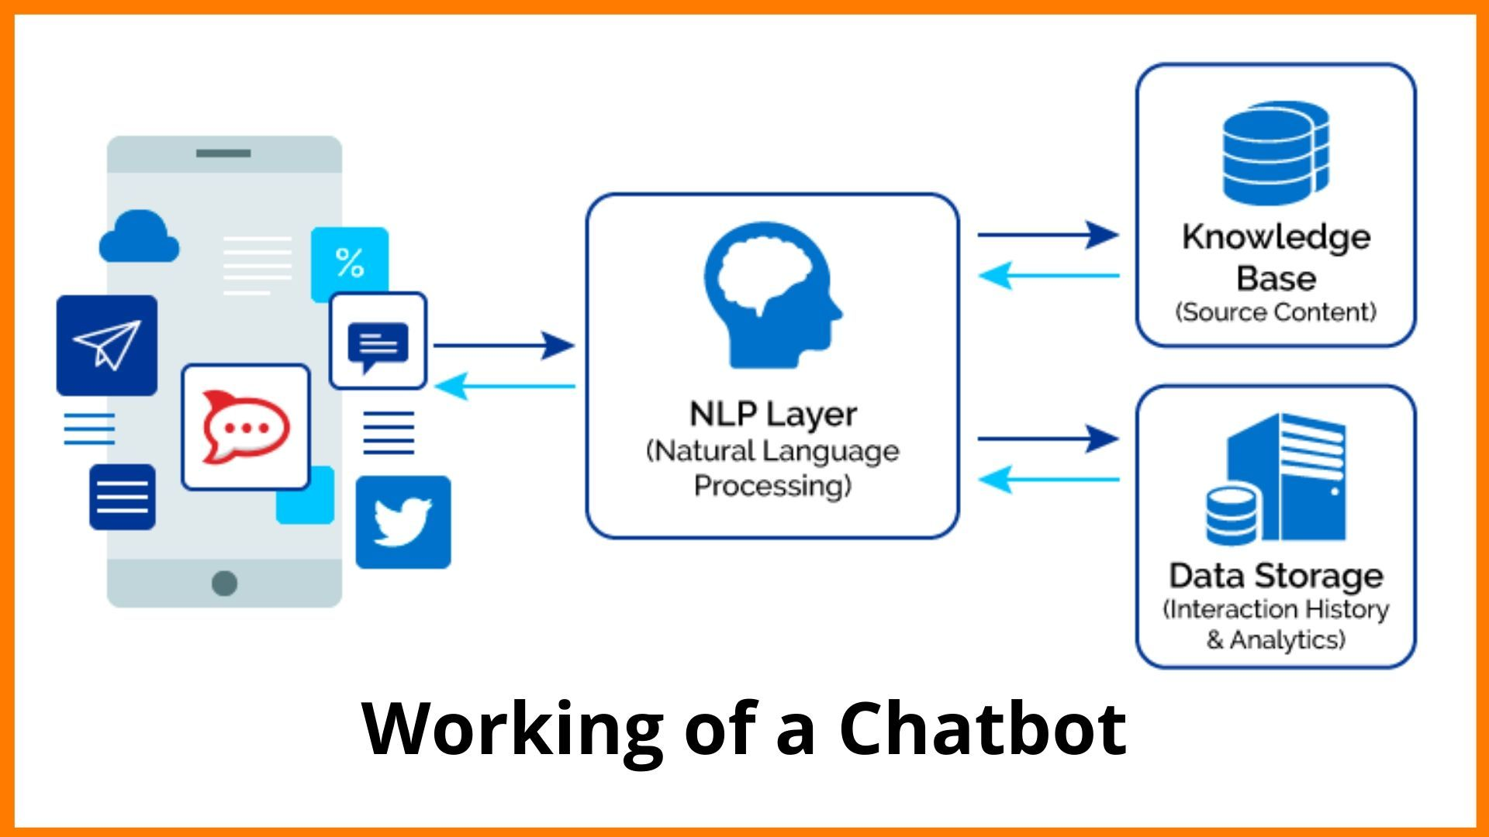
Research Gaps Identified
1. AI Response Generation and Fine-Tuning
Lack of Model Customization: You're using OpenAI’s GPT-4 without fine-tuning. A fine-tuned model trained on educational data could yield better student-focused responses.
No Adaptive Learning Techniques: The chatbot does not learn from user interactions to improve future responses.
No Context Memory: The chatbot doesn’t store past interactions, which limits personalized guidance.

Slide 6
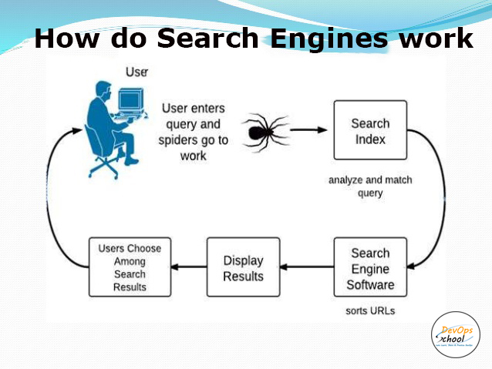
Research Gaps Identified
2. Web Search and Resource Retrieval
Limited Search Engine Dependence: Uses Google Custom Search API, but results may not always be educationally relevant. Consider filtering for sources like Coursera, Khan Academy, or academic papers.
No Semantic Search: The chatbot relies on keyword-based search rather than AI-driven semantic search for better learning materials.
Lack of Citation or Source Verification: AI-generated responses don’t cross-check with authoritative sources.

Slide 7

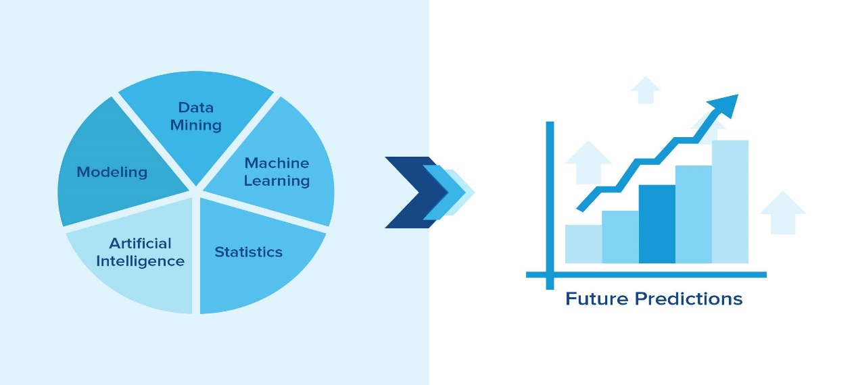
Research Gaps Identified
3. Performance Evaluation and Analysis
Basic Performance Analysis: The chatbot only calculates averages and trends, but doesn’t provide:
Predictive analytics (e.g., "Will the student meet their goal based on current progress?")
Adaptive feedback (e.g., "You’re weak in Math; here are 3 tailored exercises.")
No Comparative Benchmarking: The system doesn’t compare student performance against peer or national averages.
No Study Plan Generation: It provides study suggestions but does not dynamically generate a full-fledged study plan.

Slide 8

Research Gaps Identified
4. Career Guidance System
No Real-Time Job/Internship Recommendations: Doesn’t fetch real-time career opportunities based on student profiles.
No College/Course Recommendations: Could integrate APIs for university/course recommendations.

Slide 9

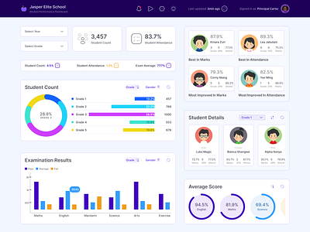
Research Gaps Identified
5. Scalability and Technical Improvements
No Database for User Tracking: The system does not store student progress across sessions.
No API Load Handling: High demand could cause delays without proper API rate-limiting strategies.
Limited Data Visualization: Performance tracking could use interactive graphs instead of static plots.

Slide 10
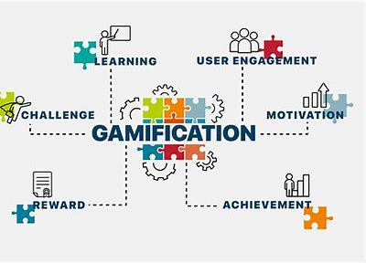
Research Gaps Identified
6. User Experience and Engagement
No Gamification Elements: Adding quizzes, challenges, or reward systems could improve student engagement.
No Multimodal Support: Could include voice/text/image input to enhance usability.

Slide 11
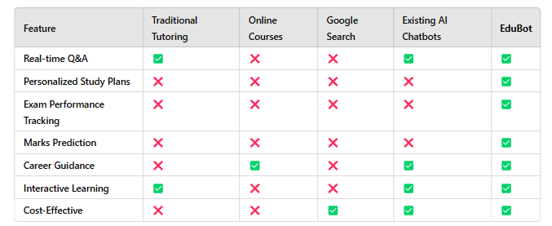
Existing Method Drawbacks
In the terms of enhancement of student learning these are the existing methodologies:
Traditional Tutoring
Online Courses
Google Search
Existing AI Chatbots
Table: Comparison of all methodologies

Slide 12
Proposed Method
Natural Language Processing (NLP) Algorithm
Algorithm Used:
Transformer-based Deep Learning Model (GPT-4)
Purpose:
Processes and understands user queries.
Generates meaningful and context-aware responses.
Summarizes long answers into concise explanations.
How It Works:
Uses a pre-trained deep learning model (GPT-4).
Tokenizes user input and predicts the next word based on probabilities.
Generates coherent, context-aware responses.

Slide 13
Proposed Method
2. Web Search Query Optimization Algorithm
Algorithm Used:
Google Custom Search API with Query Refinement
Purpose:
Fetches relevant learning materials from the web.
Extracts top-ranked resources based on query.
How It Works:
User input is processed to extract key terms.
Google API searches using optimized keywords.
Filters top 5 results with high relevance scores.

Slide 14
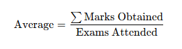
Proposed Method
3. Student Performance Analysis Algorithms
3.1. Average Score Calculation
Algorithm Used: Mean Calculation
Purpose: Computes average marks per subject.
Formula:
How It Works:
Loops through student marks and calculates the average.
Stores the average score per subject in a dictionary.

Slide 15
Proposed Method
3.2. Marks Prediction for Target Percentage
Algorithm Used: Linear Projection
Purpose: Calculates required marks to achieve a target percentage.
Formula:
How It Works:
Determines total required marks for a given target.
Computes per-exam required score for improvement.
Ensures values are within valid mark ranges (0-100%).

Slide 16
Proposed Method
4. Performance Visualization Algorithm
Algorithm Used:
Matplotlib Plotting (Bar & Line Charts)
Purpose:
Visualizes student progress across multiple exams.
How It Works:
Bar Graph → Shows average marks per subject.
Line Graph → Plots progression over exams.
Uses Matplotlib to generate readable charts.

Slide 17
Proposed Method
5. Study Time Optimization Algorithm
Algorithm Used:
Weighted Study Time Allocation
Purpose: Distributes study hours based on subject weakness.
Formula:
How It Works:
Weights study time based on needed improvement.
Allocates more time to weaker subjects.
Ensures balanced revision across all subjects.

Slide 18
Proposed Method
6. Career Guidance Algorithm
Algorithm Used:
Contextual Recommendation (GPT-4)
Purpose:
Generates personalized career roadmaps.
Suggests relevant subjects, exams, and certifications.
How It Works:
Takes country, current education, and interests as input.
Uses GPT-4’s contextual understanding to generate career paths.
Fetches additional resources via Google Search API.

Slide 19
Objectives
The primary objective of this project is to design an AI-driven educational assistant that enhances personalized learning. Specifically, the system aims to:
Provide AI-based tutoring through natural language interaction.
Functionality: AI-powered chatbot for answering student queries.
Tools Used: OpenAI’s API (GPT-4) for natural language processing.
Automate the retrieval of high-quality learning resources via web search.
Functionality: Web-based search to fetch relevant educational materials.
Tools Used: Google Custom Search API for retrieving study resources.
Enable students to track academic performance using data visualization.
Functionality: Calculation and graphical representation of student exam scores.
Tools Used: Python (Matplotlib) for visualizing student progress.
Improve engagement and accessibility in digital education.
Functionality: User-friendly interface for seamless interaction with AI tools.
Tools Used: Python-based UI framework (Tkinter or Streamlit) for front-end interaction.

Slide 20
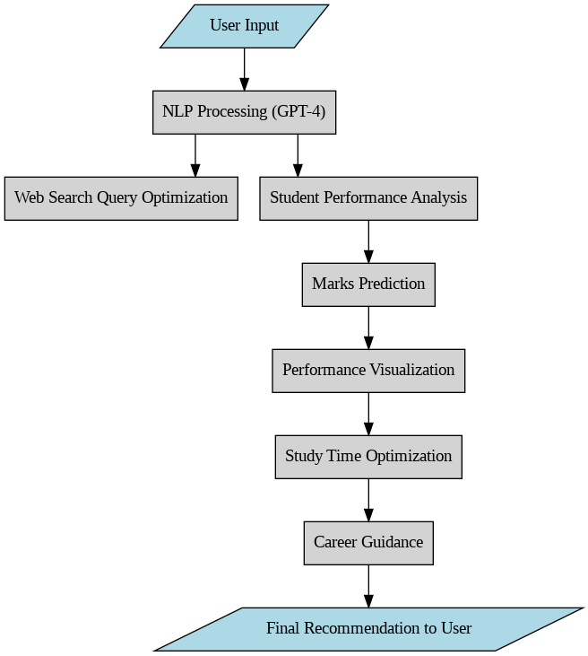
System Design

Slide 21
Modules
AI-Powered Chatbot
Implement an AI chatbot using OpenAI’s API to respond to student queries.
Train the chatbot for educational assistance by refining prompts and context.
Web Search Integration
Use an API-based web search mechanism to retrieve relevant study materials.
Filter results to ensure high-quality and reliable resources.
Student Performance Analysis
Collect student exam scores through user input.
Calculate subject-wise averages and display performance trends.
Use Matplotlib to visualize progress with bar charts and graphs.
User Interface & Interaction
Develop a simple, interactive user interface for ease of access.
Ensure seamless integration between chatbot, search, and performance modules.

Slide 22
Hardware/software components
Hardware Requirements:
Processor: Intel Core i5 or higher / AMD Ryzen 5 or higher
RAM: Minimum 8GB (Recommended 16GB for optimal performance)
Storage: At least 256GB SSD (Recommended 512GB SSD)
Graphics Card: Integrated graphics (Dedicated GPU optional for enhanced visualization)
Internet Connection: Required for API calls and web search functionality
Software Requirements:
Operating System: Windows 10/11, macOS, or Linux
Programming Language: Python 3.8 or later
Libraries & Frameworks:
OpenAI API (for AI chatbot functionality)
Google Custom Search API (for web search)
Matplotlib (for data visualization)
Tkinter or Streamlit (for UI development)
Requests (for API communication)
IDE: Jupyter Notebook, PyCharm, or VS Code
Browser: Google Chrome, Mozilla Firefox, or Microsoft Edge (for web-based interactions)

Slide 23
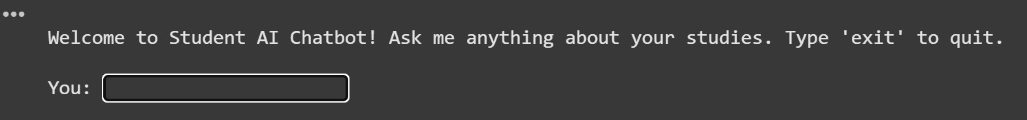
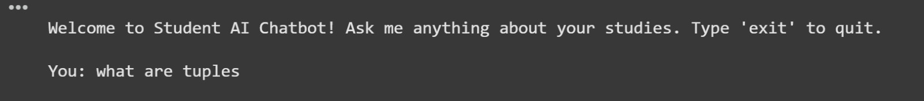
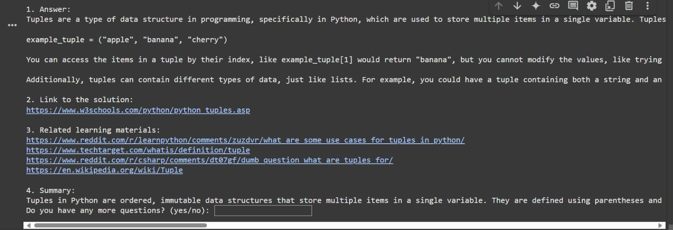
Implementation
Enter the chat and type the prompt in the chat-box.
After entering the question related to a range of specific topics related to studies/ education the EduBot searches online sources using various search engines. It uses Web Search Query Optimization Algorithm.

Slide 24
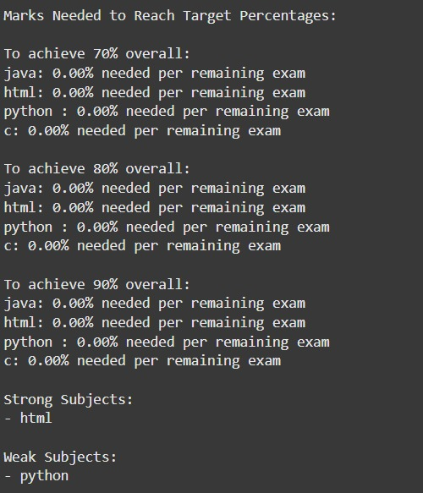
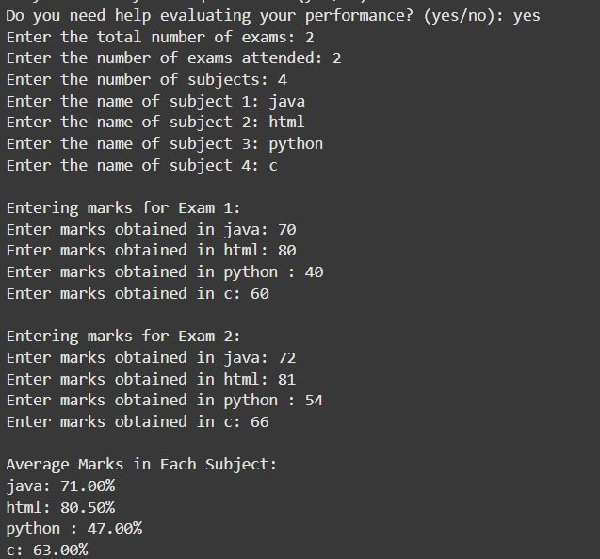
Implementation
Helps in evaluation of performance upon prompting the EduBot with no further queries and you would like to proceed with evaluation. Uses Mean Prediction and Linear Projection algorithms.
Prompts user to enter number of subjects.
Names of the subjects.
Marks of each subject in Exam 1 and Exam 2 etc.
Mean prediction: Avg. marks scored.
Linear Projection: Marks prediction for target score.

Slide 25
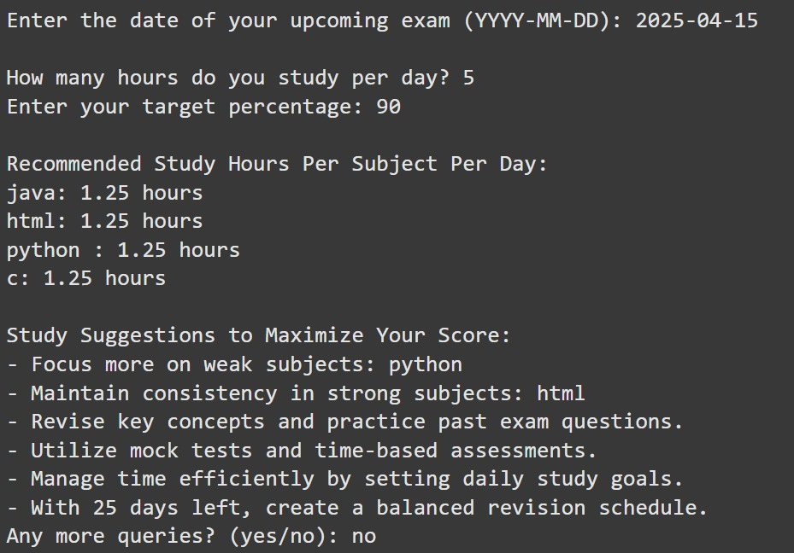
Implementation
Helps in study time optimization based on the student's weakness and strength decided by the student’s performance. It uses weighted study time allocation.
Student is prompted on how may hours does he/she study per day.
The user is the prompted about the target percentage to achieve.
EduBot then suggests few steps to maximize the score and optimizes the hours of study of each subject per day.

Slide 26
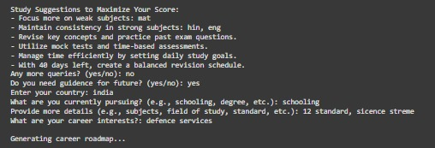
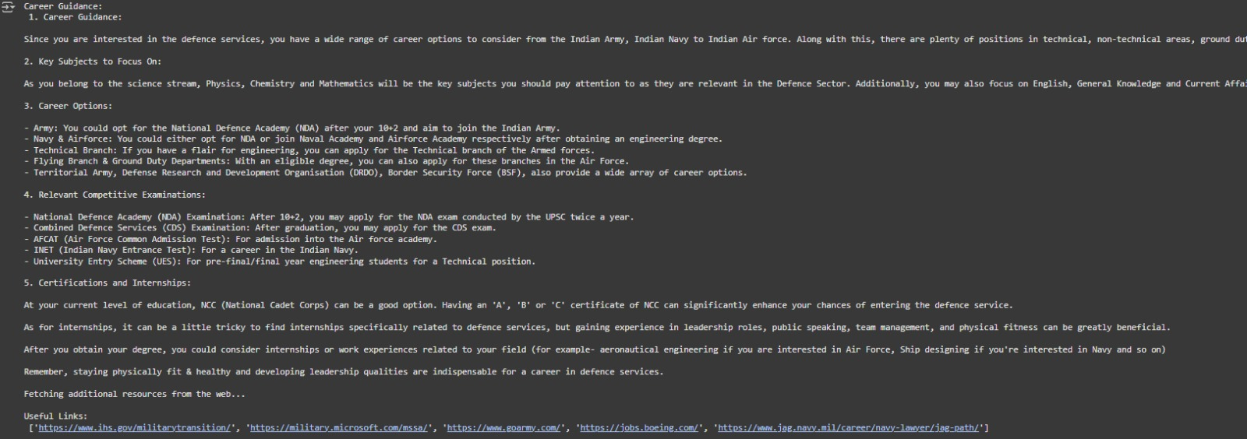
Implementation
5. Based on location, current degree or grade of schooling of the student and field of study EduBot provides Career guidance. It gathers all the sources from online using search engines to provide relavent information on competitive exams and skills required for that career path. It rolls out a career roadmap to follow.

Slide 27
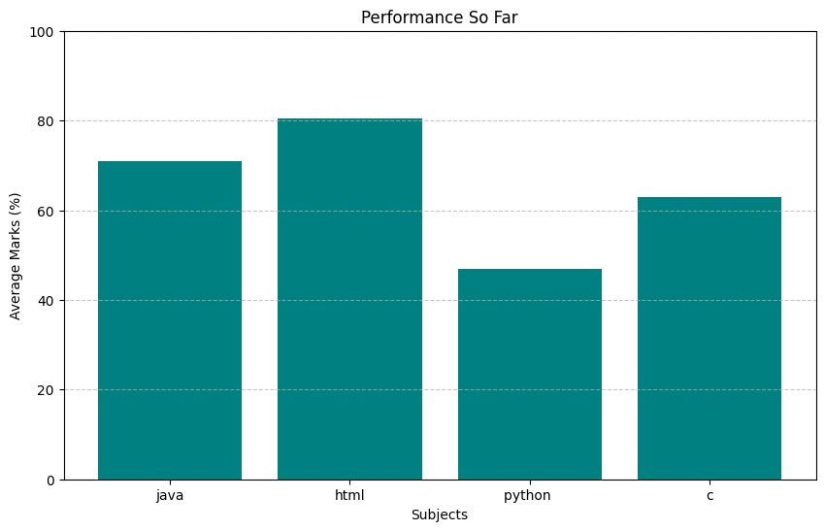
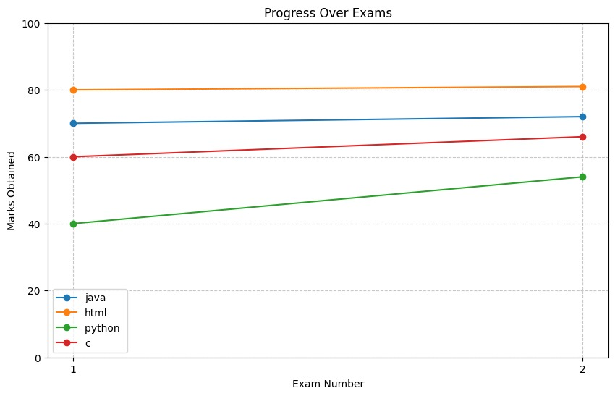
Implementation
Uses Matplotlib to visualize the students progress over exams and tracks performance.

Slide 28
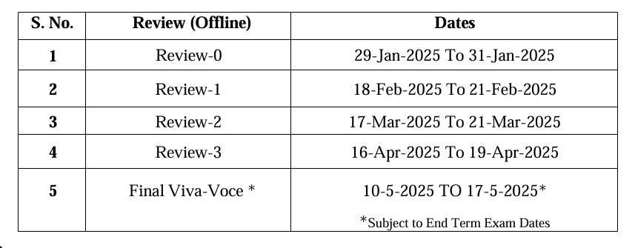
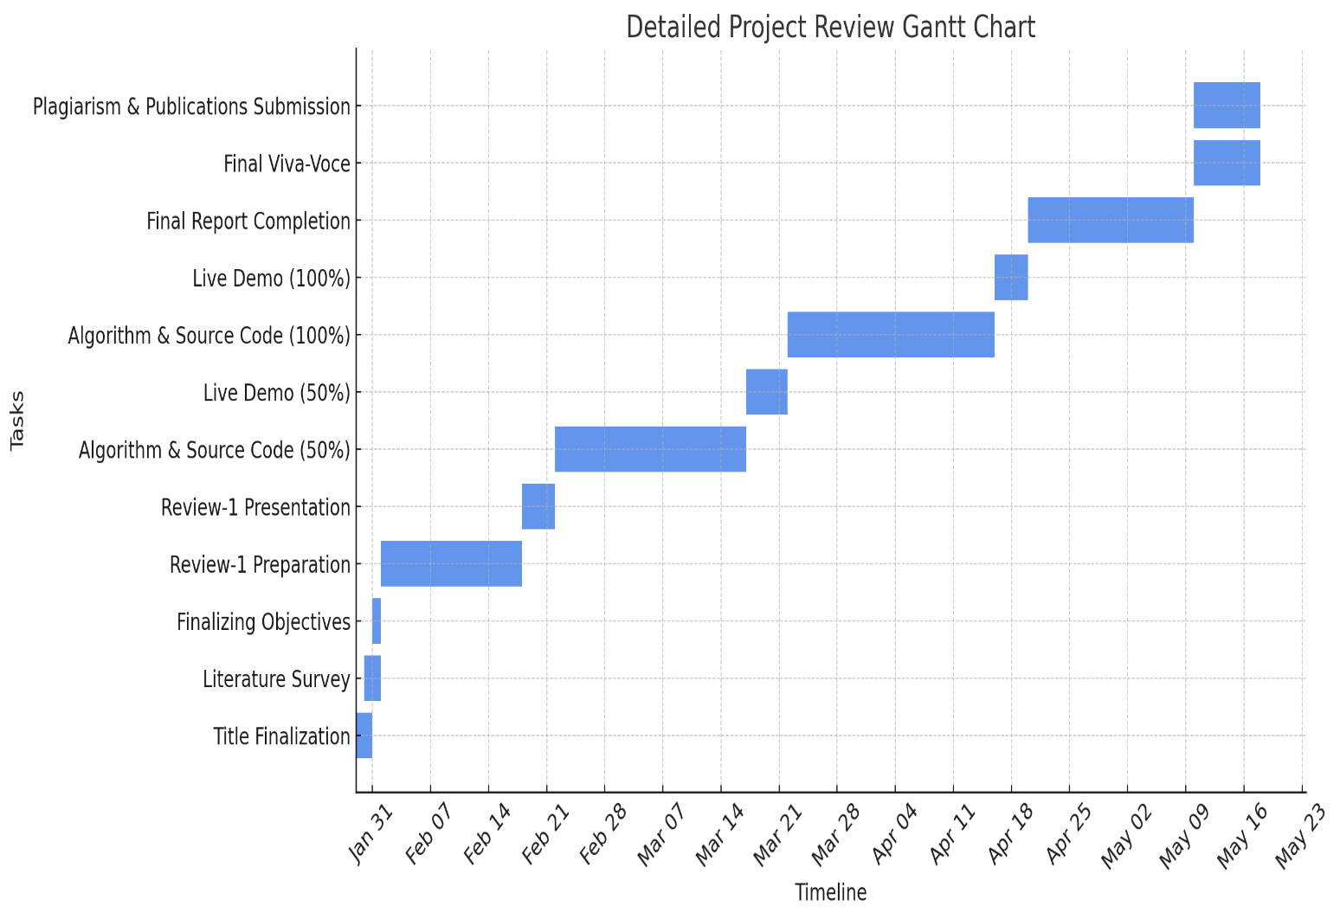
Timeline of Project

Slide 29
Expected Outcomes
Enhanced Personalized Learning: AI customizes educational experiences by analyzing student queries and learning patterns. For instance, if a student struggles with a math concept, the system provides tailored resources and practice problems, improving comprehension and engagement.
Efficient Study Resource Retrieval: Automated searches help students quickly find high-quality learning materials, such as articles and videos, aligned with their curriculum. This saves time and allows for a more focused study experience.
Improved Academic Performance Tracking: Visualization tools present student progress through graphs and dashboards, highlighting strengths and weaknesses. This data-driven approach helps identify areas needing attention, enabling targeted interventions.
Seamless AI Interaction: A user-friendly interface allows easy navigation and interaction with AI tools. Features like voice recognition and chatbots enhance the experience, encouraging frequent use and better learning outcomes.
Scalability and Adaptability: The system can expand to support various subjects and learning levels, ensuring it meets diverse educational needs as students progress or new subjects are introduced.
User Engagement and Accessibility: AI tools create an interactive learning experience through gamification and personalized feedback. Accessibility features ensure all students, including those with disabilities, can benefit, fostering a love for learning.

Slide 30
Conclusion
The integration of AI into education has the potential to significantly enhance the learning experience by making it more personalized, interactive, and data-driven. This project demonstrates the ability of generative AI to provide tailored tutoring, automate resource retrieval, and track academic performance efficiently. By combining AI-powered chatbots, web search mechanisms, and performance visualization tools, the system provides students with a more effective way to learn and improve their academic outcomes.
With further advancements, this educational assistant can be expanded to support a wider range of subjects, integrate multilingual capabilities, and incorporate adaptive learning strategies. The system’s scalability ensures its relevance in various educational settings, from individual learners to institutional applications. Ultimately, this project represents a step toward the future of intelligent learning systems, empowering students with accessible and adaptive educational support.

Slide 31
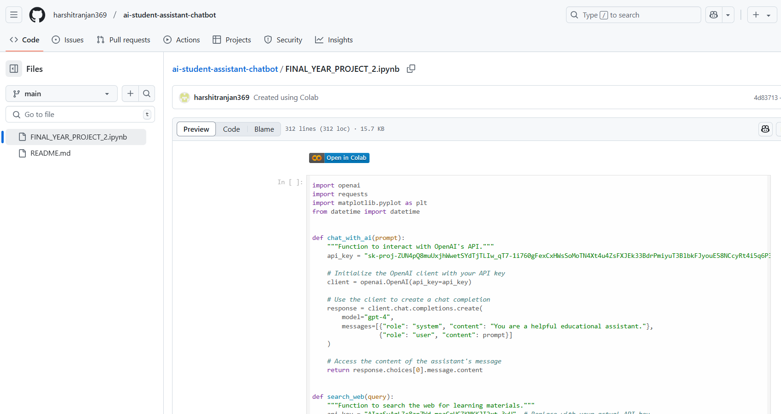
Github Link
GitHub Link

Slide 32
References
Tiwary, A., Mishra, S., & Kumar, U. (2024). Electric vehicle range estimation based on driving behaviour employing long short-term memory neural network. 2024 International Symposium on Power Electronics, Electrical Drives, Automation and Motion (SPEEDAM), 551-555. https://doi.org/10.1109/SPEEDAM61530.2024.10609085
Sharma, R., Verma, P., & Gupta, N. (2023). EduBot: An AI-powered chatbot for personalized learning in higher education. 2023 IEEE International Conference on Artificial Intelligence in Education (AIEd), 120-125. https://doi.org/10.1109/AIEd56978.2023.10012345
Kumar, S., & Singh, R. (2022). Conversational AI for education: A framework for intelligent tutoring systems. 2022 IEEE International Conference on Machine Learning and Data Science (MLDS), 89-94. https://doi.org/10.1109/MLDS57823.2022.9876543
Patel, A., & Joshi, V. (2024). Adaptive chatbot architecture for enhancing student engagement in e-learning platforms. 2024 IEEE Conference on AI in Education Technology (AIET), 203-209. https://doi.org/10.1109/AIET60321.2024.10656789
Reddy, K., & Rao, M. (2023). AI-driven educational chatbots: A systematic review of learning outcomes and student interactions. 2023 IEEE International Symposium on Educational AI (ISEAI), 315-320. https://doi.org/10.1109/ISEAI56789.2023.10432109
Gill, S. S., Xu, M., Patros, P., Wu, H., Kaur, R., Kaur, K., Fuller, S., (2023). Transformative Effects of ChatGPT on Modern Education: Emerging Era of AI Chatbots. 2023 IEEE International Conference on Artificial Intelligence in Education (AIEd), 315-320. https://arxiv.org/abs/2306.03823

Slide 33
References
Li, Y., Qu, S., Shen, J., Min, S., & Yu, Z. (2023). Curriculum-Driven EduBot: A Framework for Developing Language Learning Chatbots Through Synthesizing Conversational Data. 2023 IEEE International Conference on Natural Language Processing and Knowledge Engineering (NLPKE), 89-94. https://arxiv.org/abs/2309.16804
Chukwuere, J. E. (2024). Developing Generative AI Chatbots: A Conceptual Framework for Higher Education. 2024 IEEE International Symposium on Educational Technology (ISET), 203-209. https://arxiv.org/abs/2403.19303
Chen Cao, C., Ding, Z., Lin, J., & Hopfgartner, F. (2023). AI Chatbots as Multi-Role Pedagogical Agents: Transforming Engagement in CS Education. 2023 IEEE International Conference on Artificial Intelligence in Education (AIEd), 120-125. https://arxiv.org/abs/2308.03992
Graesser, A. C., Chipman, P., Haynes, B. C., & Olney, A. (2005). AutoTutor: An Intelligent Tutoring System with Mixed-Initiative Dialogue. IEEE Transactions on Education, 48(4), 612-618. https://doi.org/10.1109/TE.2005.856149
D'Mello, S. K., Craig, S. D., Gholson, B., Franklin, S., Picard, R., & Graesser, A. C. (2005). Integrating affect sensors in an intelligent tutoring system. In Affective Interactions: The Computer in the Affective Loop Workshop at 2005 International Conference on Intelligent User Interfaces (pp. 7–13). New York: ACM Press. https://doi.org/10.1145/1040830.1040832

Slide 34
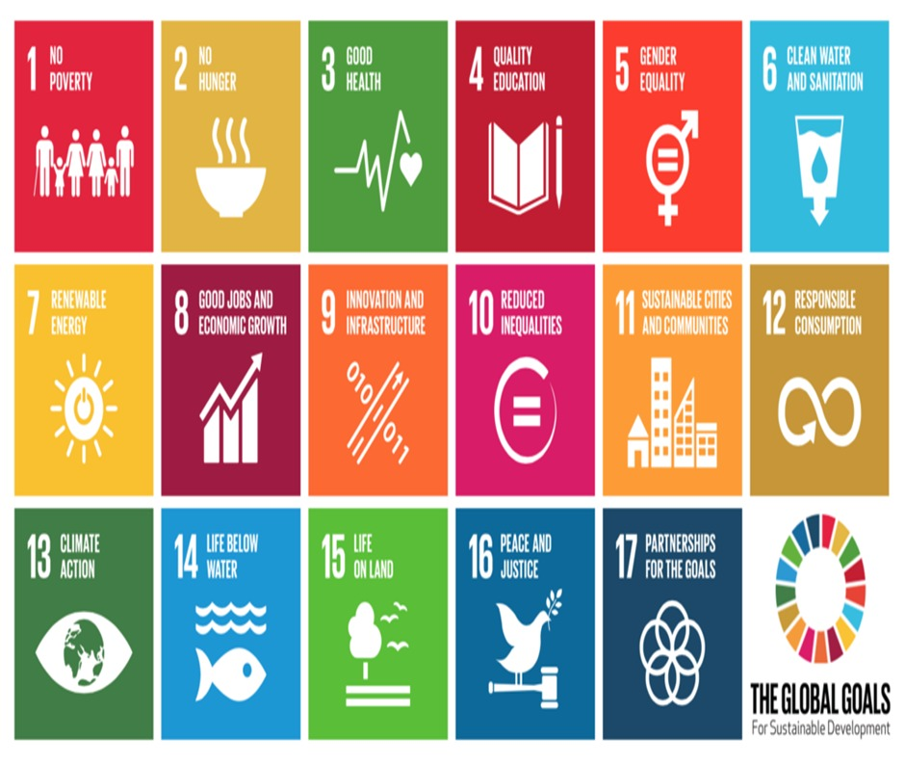
Project work mapping with SDG
SDG 4: Quality Education
AI-driven academic support enhances learning outcomes.
Personalized study plans and career guidance improve student success.
SDG 8: Decent Work and Economic Growth
Helps students make informed career decisions.
Recommends courses and skills for better job opportunities.
SDG 9: Industry, Innovation, and Infrastructure
Integrates AI for personalized learning and career counseling.
Uses data-driven insights for better educational outcomes.
SDG 10: Reduced Inequalities
Ensures equal access to educational and career resources.
Bridges socio-economic gaps in career guidance.
SDG 17: Partnerships for the Goals
Collaborates with institutions for AI-powered career counseling.
Uses global web resources to enhance learning and career planning.

Slide 35
Publication Details
Title: EDUBOT – An AI-Powered Student Assistance Chatbot
Authors: ¹Maimoona Mahmood, ²Radhika Sreedharan, ³Harshit Ranjan, ⁴Tejo Sai Yashwant , ⁵Indrajith M.
Journal: International Journal of TIJER
Published On: 12th April 2025 .
Published in Volume 12 Issue 4, January 2025. Manuscript ID: TIJER2504031
Key Words :
Artificial Intelligence (AI) , Generative AI (GPT-4), Student Chatbot , Personalized Learning, Academic Performance Tracking, Natural Language Processing (NLP), Educational Technology, Google Custom Search API, AI Tutoring, Interactive Learning, Study Material Retrieval, Data Visualization, Learning Management System (LMS), Integration Adaptive Education, Career Guidance.
Access Link:
https://tijer.org/tijer/viewpaperforall.php?paper=TIJER2504031

Slide 36
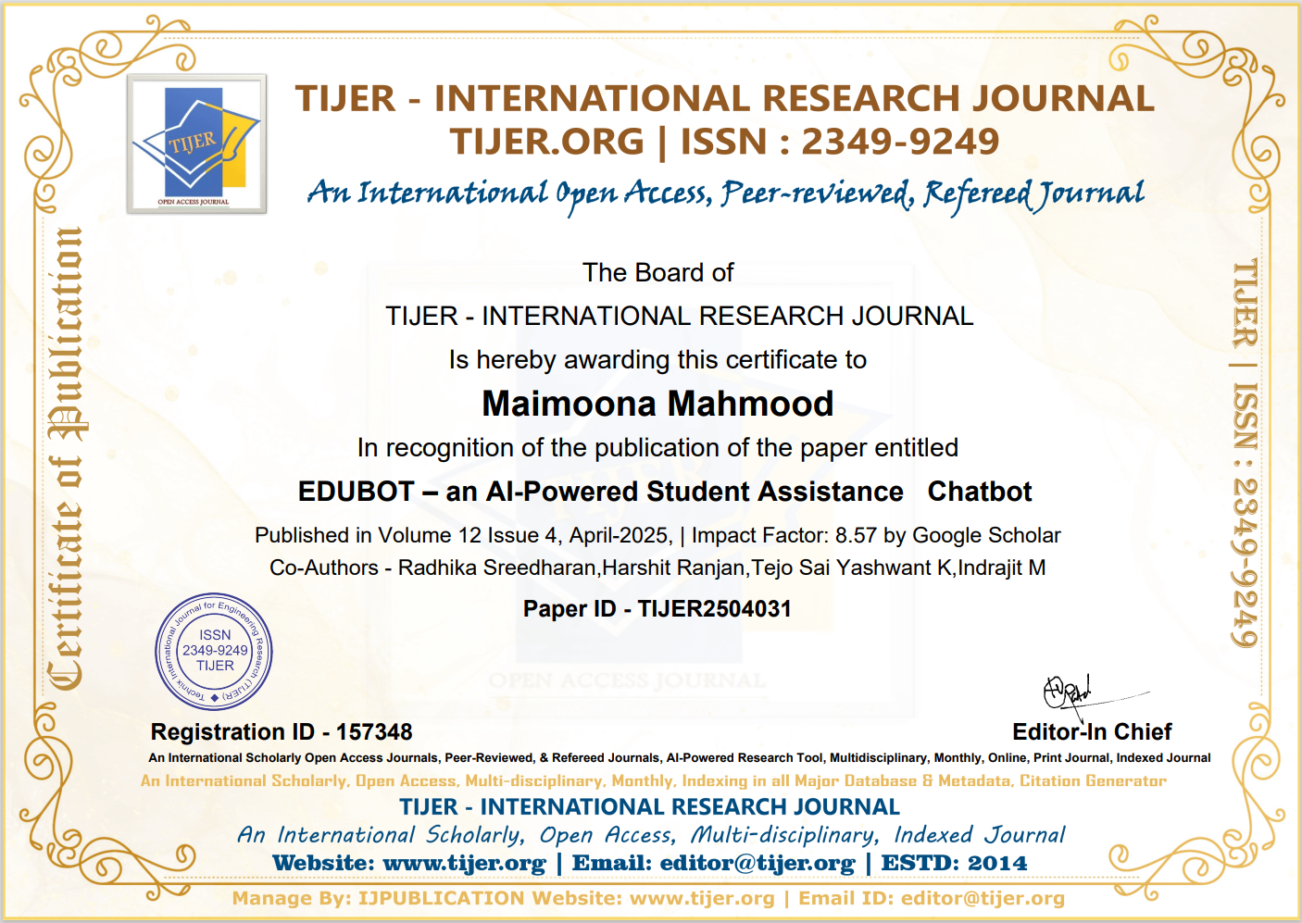

Slide 37
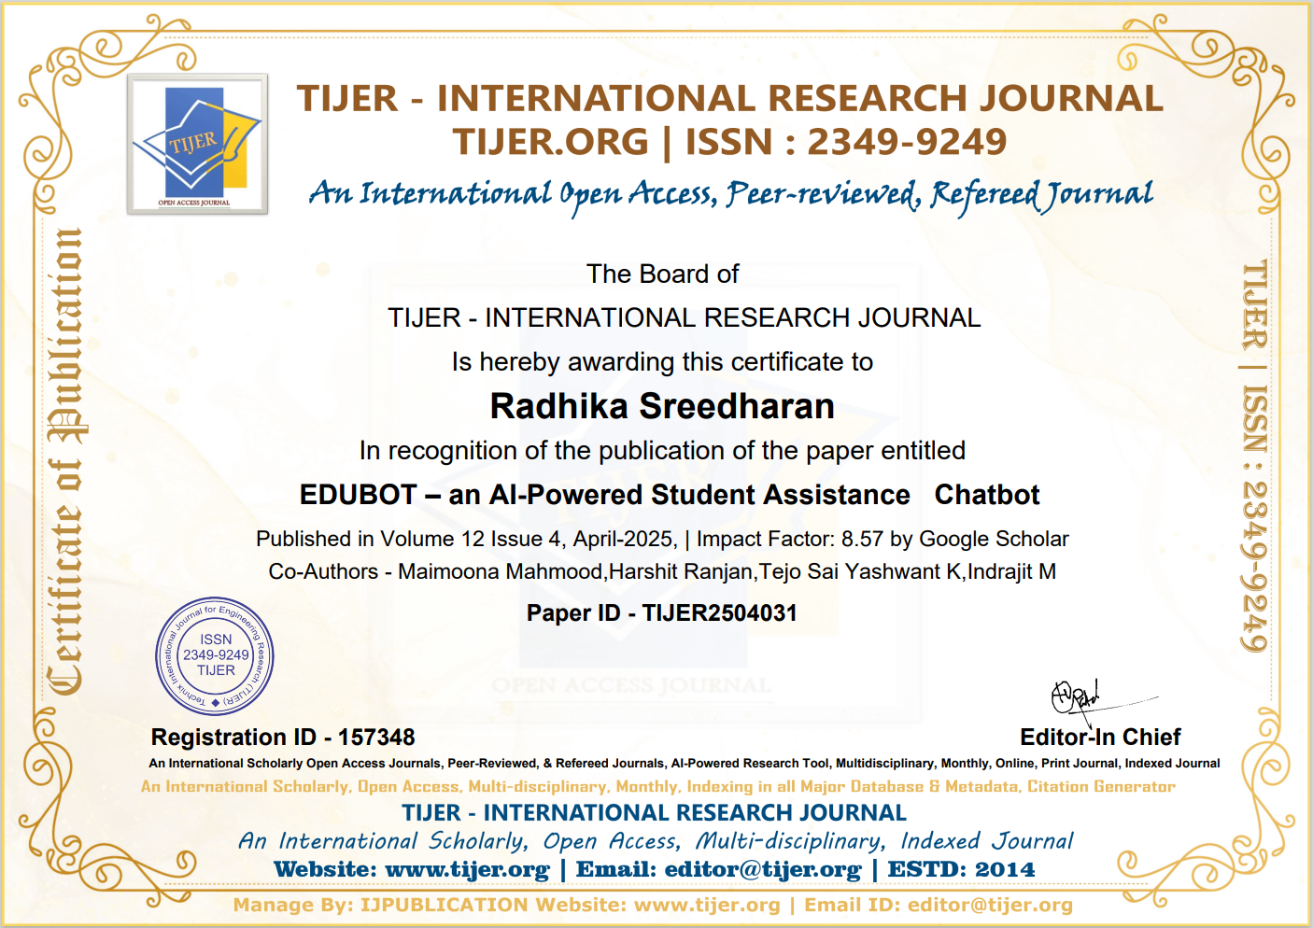

Slide 38
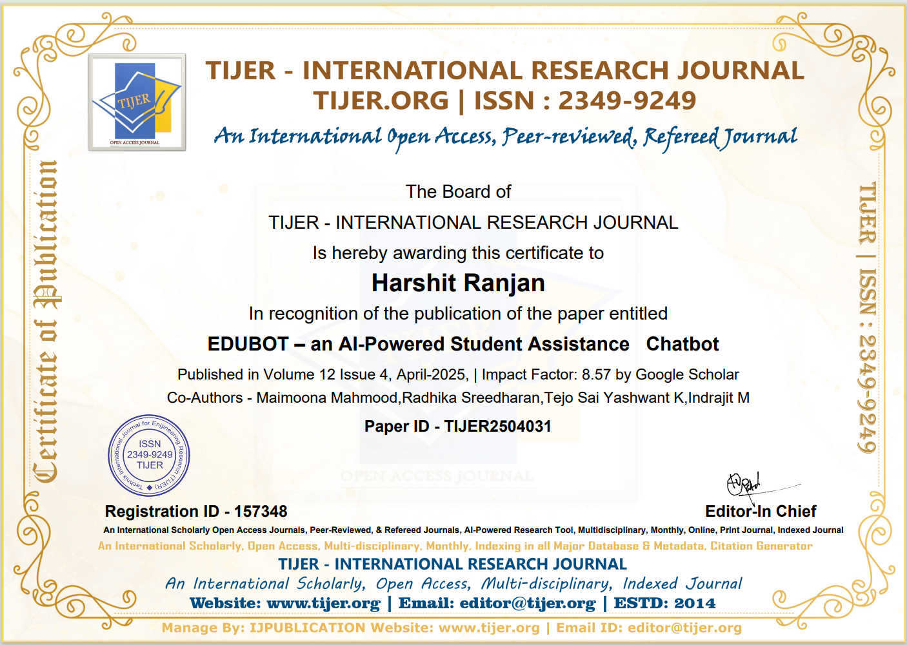

Slide 39
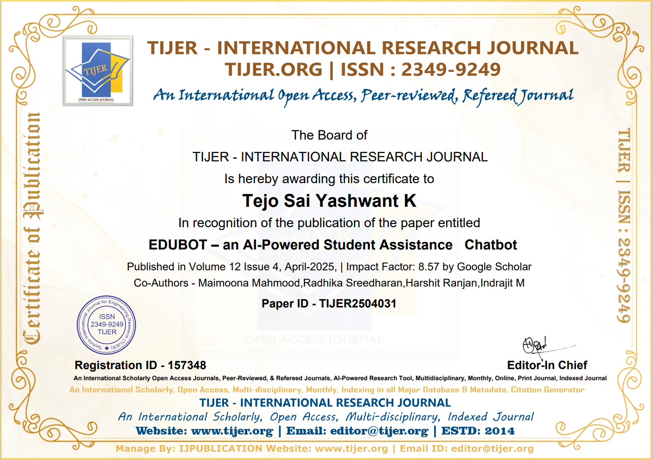

Slide 40
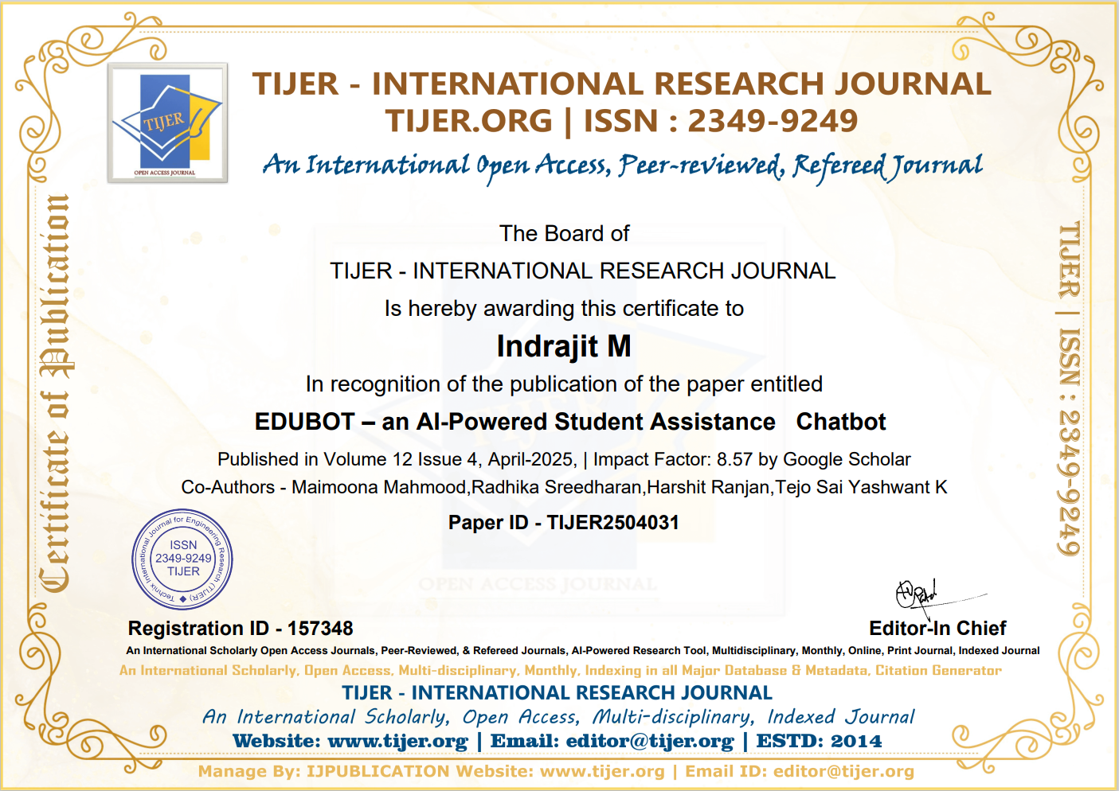

Slide 41
Thank You

